Slide 1
Lead Scoring Case Study
Group Assignment Members:
Aarif Babulal Nadaf
Gayatri R Nair
Shweta Walde

Slide 2
Problem Statement
An education company named X Education sells online courses to industry professionals.
The company receives a lot of leads from direct traffic, organic searches, google, and so on, however the conversion rate is poor.
To improve the conversion rate of the leads, the company wants to identify its potential customers based on the lead score or hot leads.
On successful identification of leads, the conversion rate inevitably will improve as the sales team will focus on the potential leads instead of making calls to everyone.
Objective
The X Education company wants to identify potential leads using logistic regression models, which can assign scores from 0 to 100 to each of the lead. A higher score would mean the lead is hot and most likely to convert.

Slide 3
SOLUTION Methodology
Data understanding and preparation
Verifying and handling duplicate data
Verifying and handling missing values
Dropping columns if it includes large amount of missing values and not useful for the analysis
Imputing values as needed
Verifying and handling outliers in data
Exploratory Data Analysis
Scaling and Creating Dummy Variables while encoding the data
Using logistic regression to make the model and perform prediction
Validating the model
Presenting the model
Conclusions and recommendation

Slide 4
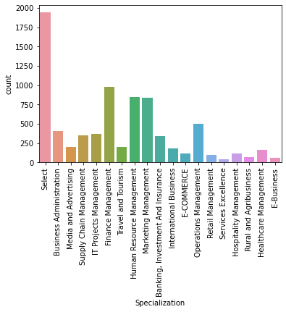
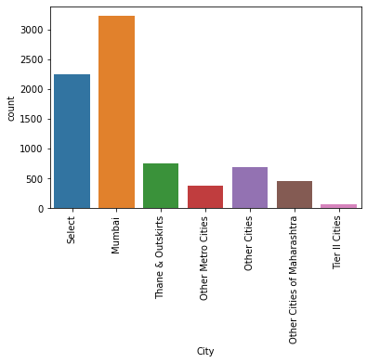
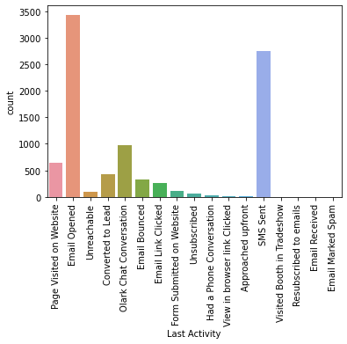
Missing Values
Identified missing values in the columns by representing it with the label “Select”

Slide 5
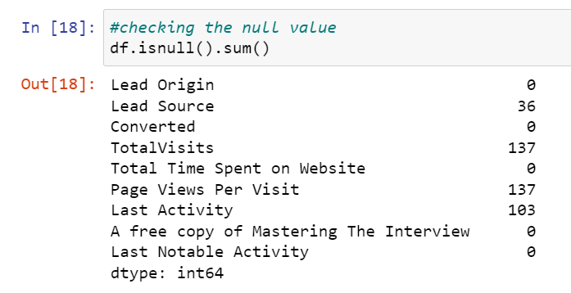
Null Values
Identified null values. As there are few columns with null values, removing it.

Slide 6
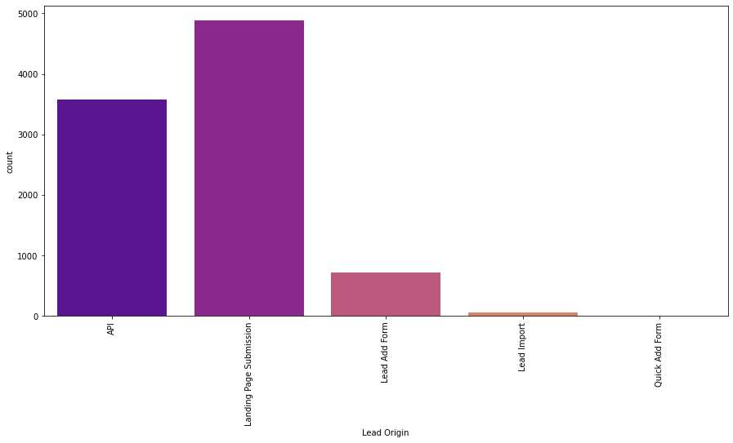
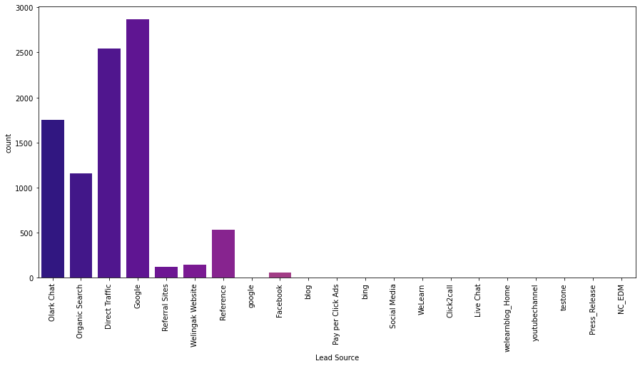
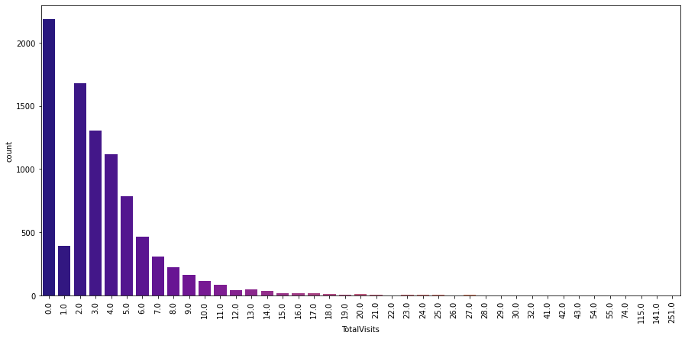
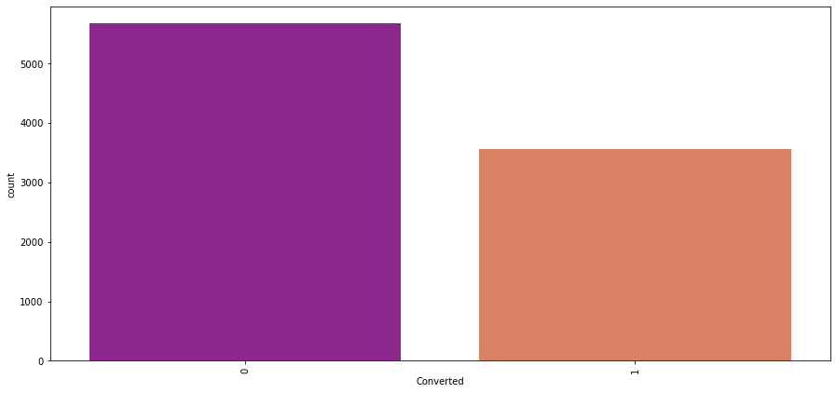
Performing EDA

Slide 7
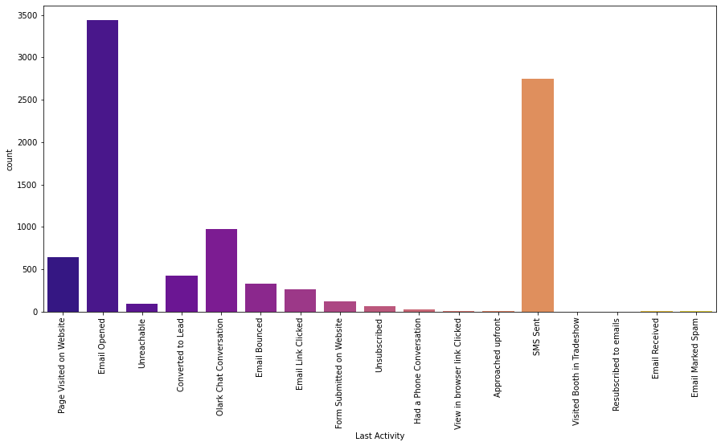
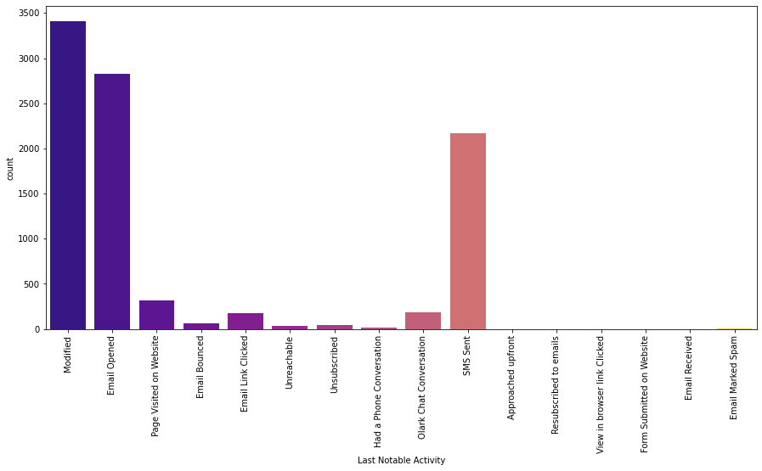
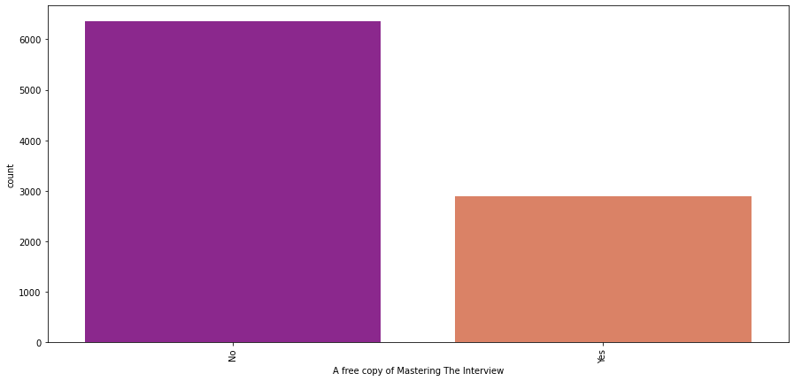
Performing EDA

Slide 8
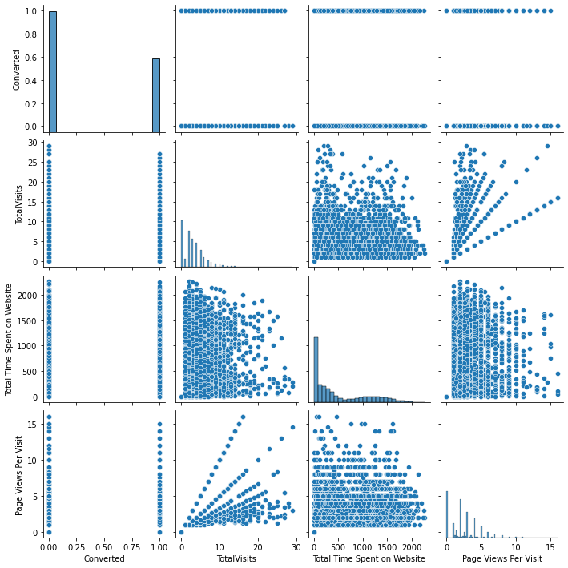
Performing EDA

Slide 9
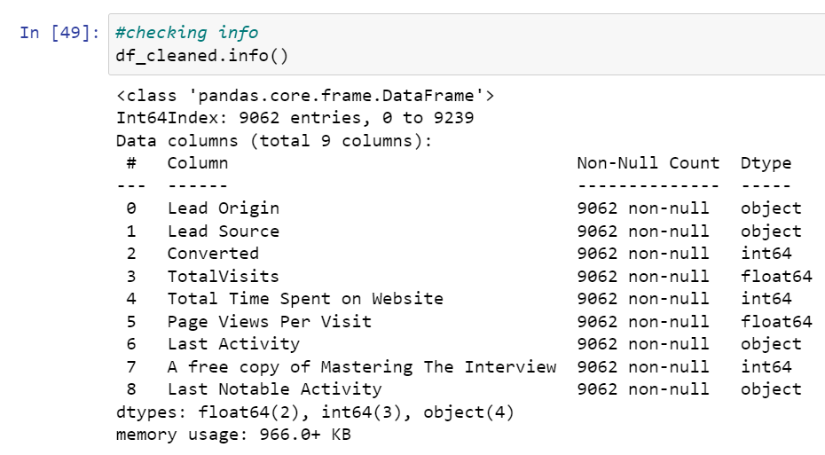
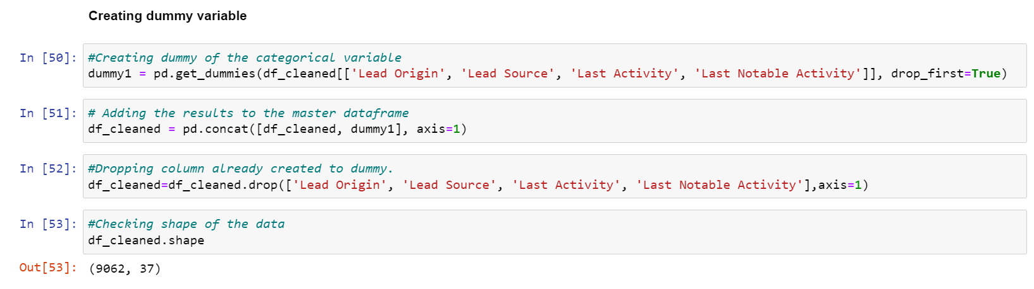
Data Preprocessing
Numeric variables are normalized
Dummy variables are created for object type variables

Slide 10
Building the MODEL
Splitting the Data into Training and Testing sets
Using RFE for feature selection
Running RFE on 15 variables as output
Removing the variable whose p- value is greater than 0.05 and vif value is greater than 5 to build the model
Making predictions on the test data set
Overall accuracy is 80%

Slide 11
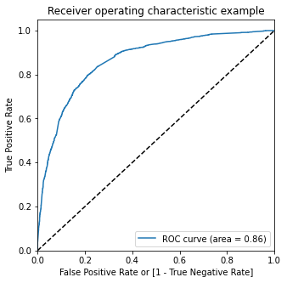
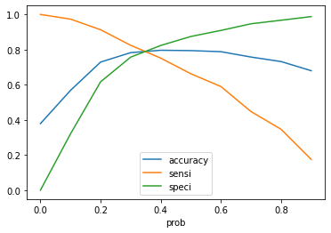
ROC Curve
From the Accuracy, Sensitiviy and Specificity Graph graph, it is apparent that the optimal cut off is at 0.35.
Evaluation after cut off points 0.35:
Accuracy - 0.7914
Sensitivity - 0.7903
False Positive Rate - 0.2096
Positive Predicted - 0.6977
Precision - 0.6977
Recall - 0.79322

Slide 12
Conclusion
These inferences were made based on the analysis:
The following sources impacted the potential leads:
Google
Direct traffic
Organic Search
The last activity that affected the leads were:
Opened emails
SMS
Olark Chat Conversation
The total time spent on the website and the total number of visits had their share of impact
Working professions contributed to the lead
Final Model (res) res = logm4.fit()
The cut off probability is 0.35
More than 0.35 were converted as lead
Less than 0.35 will not be converted as lead
Accuracy of the train data 0.791
Accuracy of the test data 0.784
When the lead is increased or decreased, the Cut off can be adjusted
The lead score targeting can be done from the top.

